Slide 1
The game of TV-Tennis
Daniel Gehrman
Maxim Nonkin
Damir Turtugeshev
Group: 23931
Novosibirsk • 2024

Slide 2
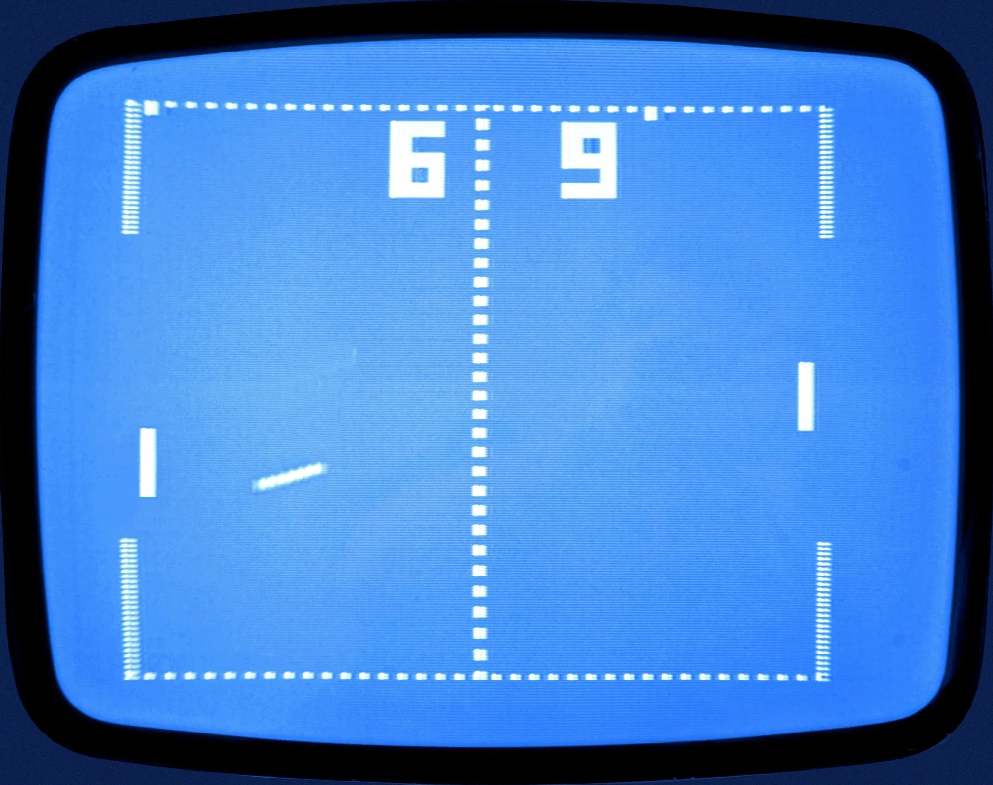
Pong
A video game classic
Simple
Elegant
1970’s household staple

Slide 3
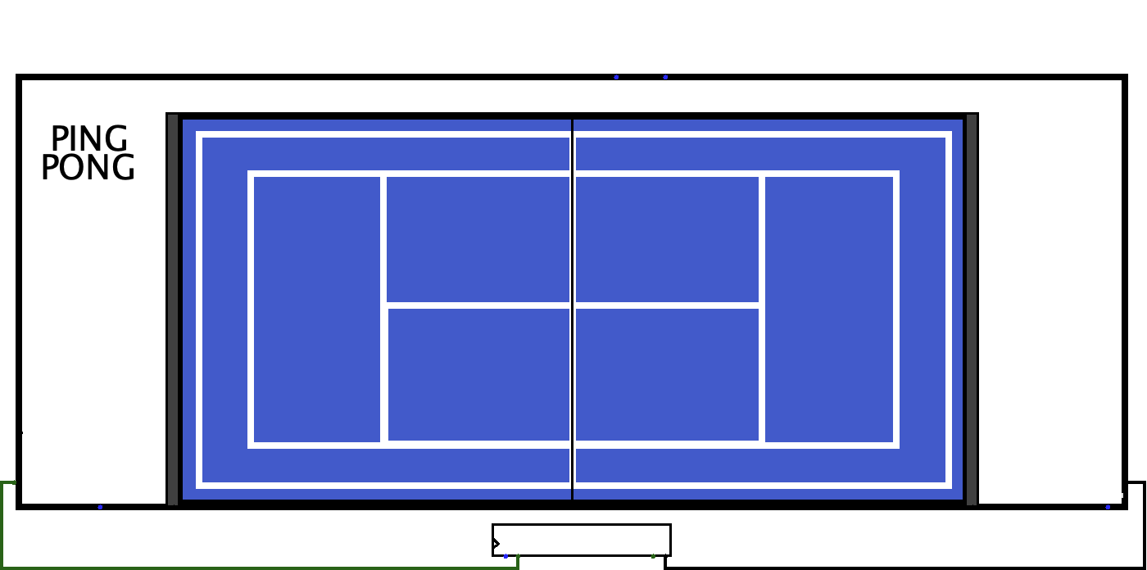

Slide 4
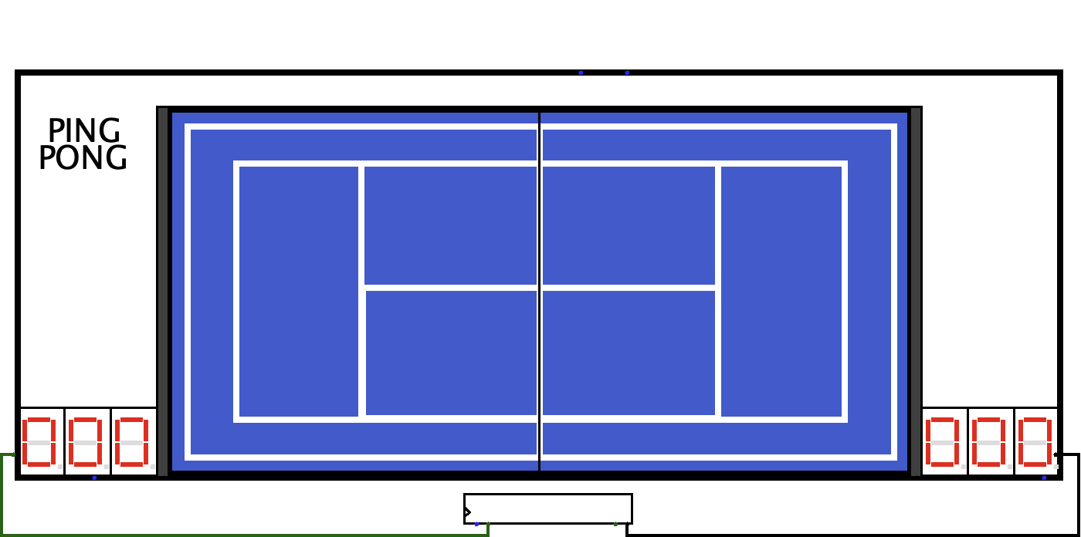

Slide 5
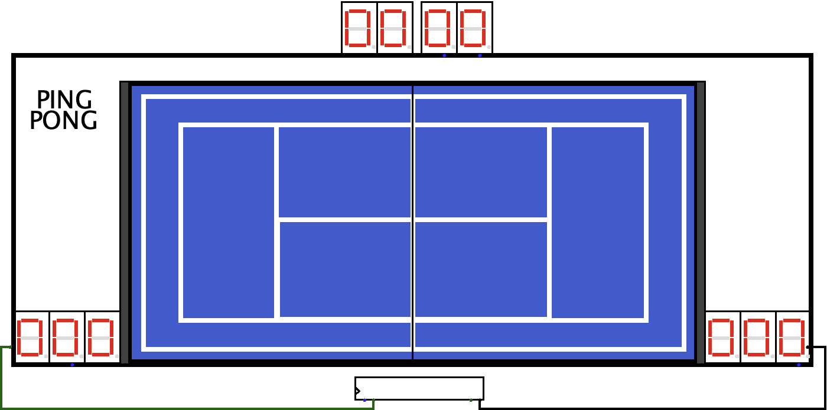

Slide 6
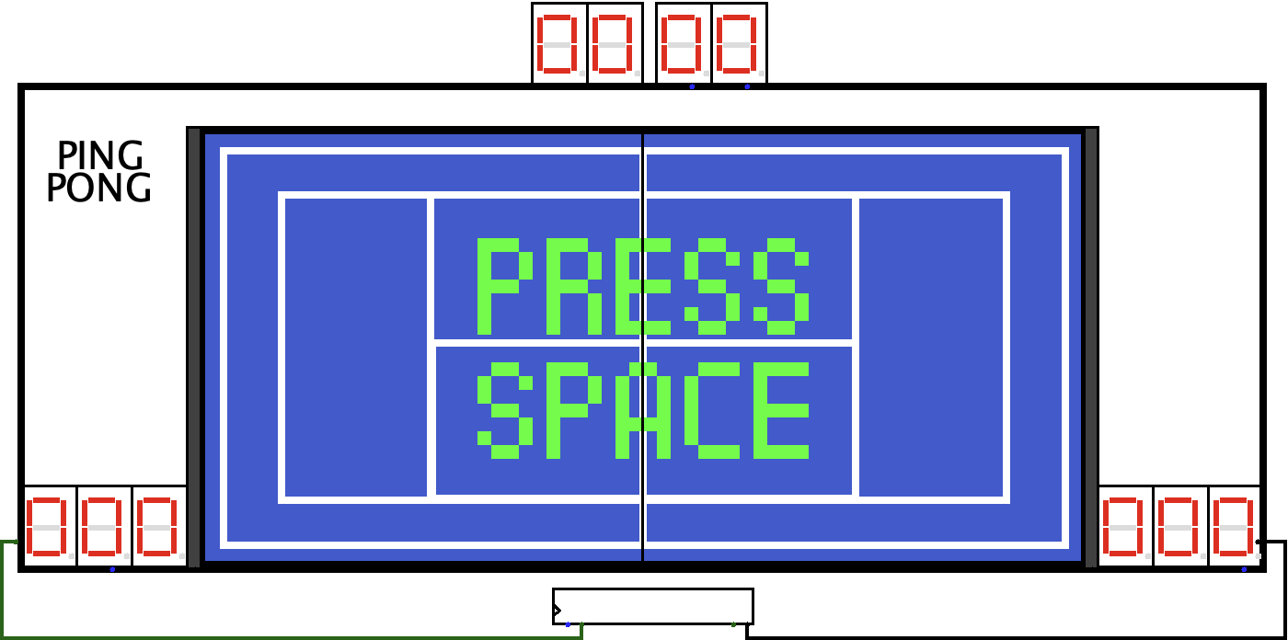

Slide 7
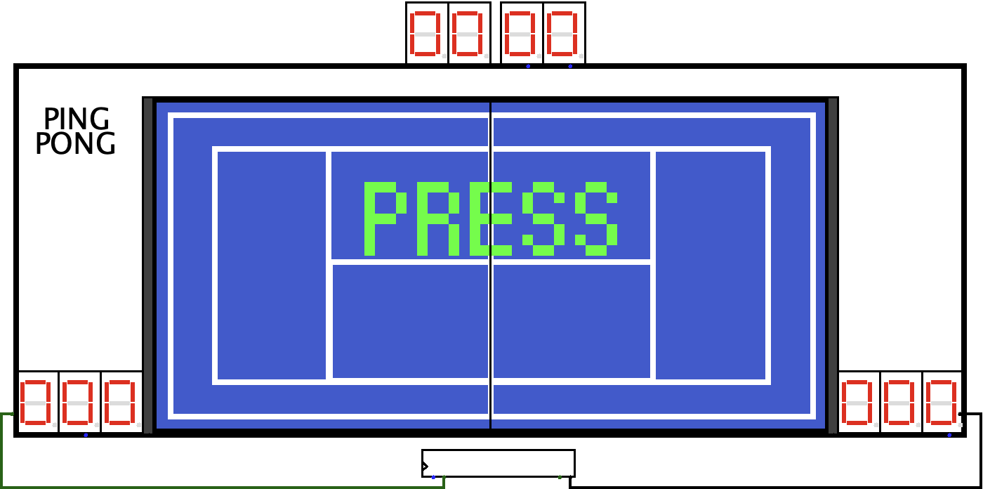

Slide 8
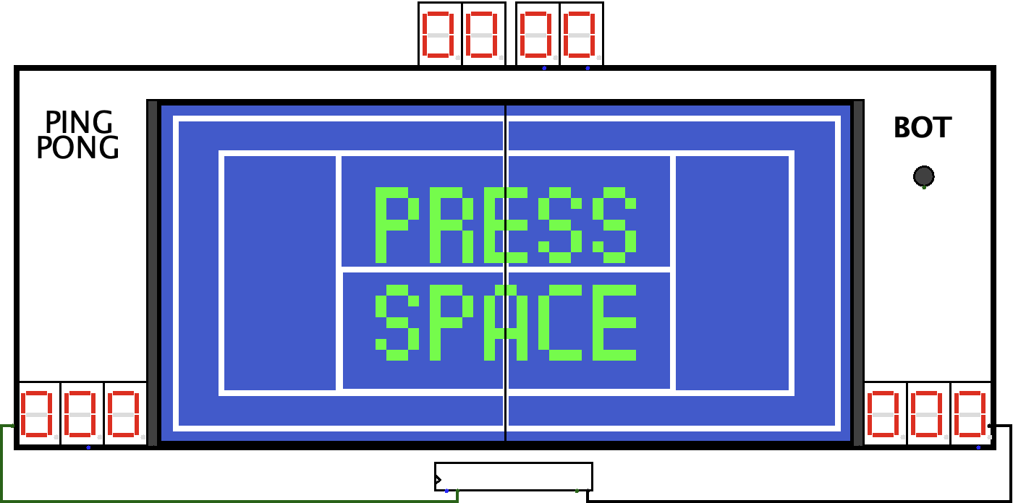

Slide 9
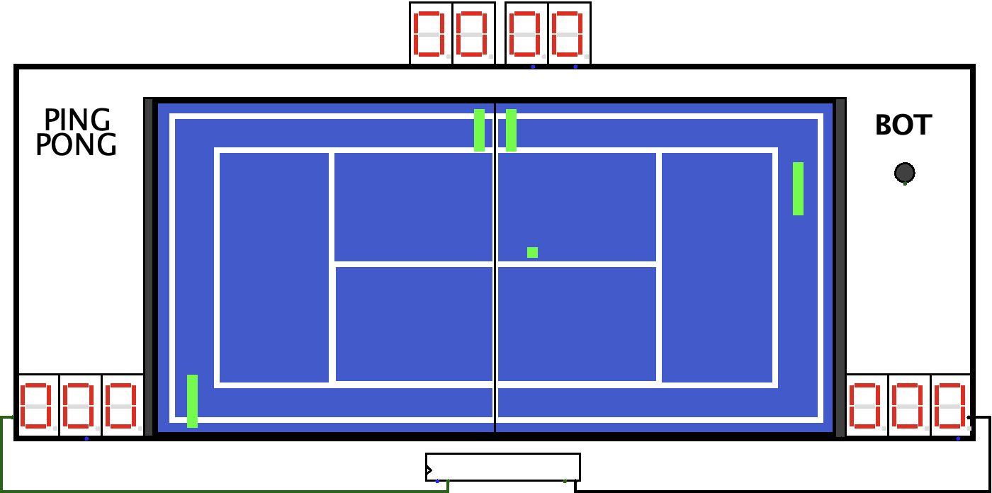

Slide 10
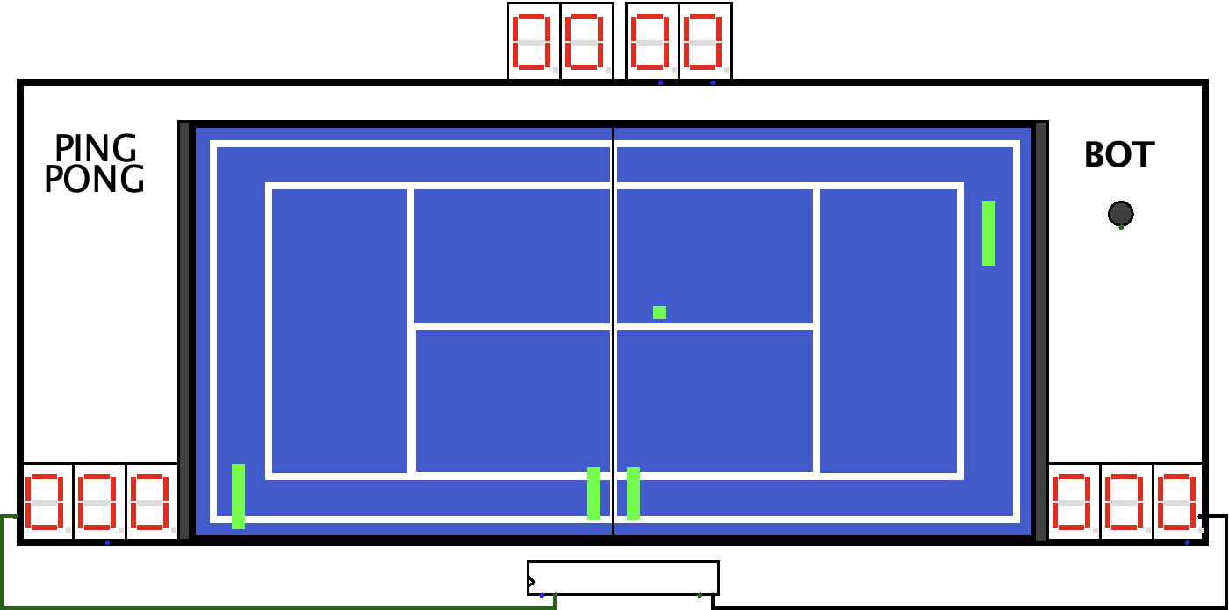

Slide 11
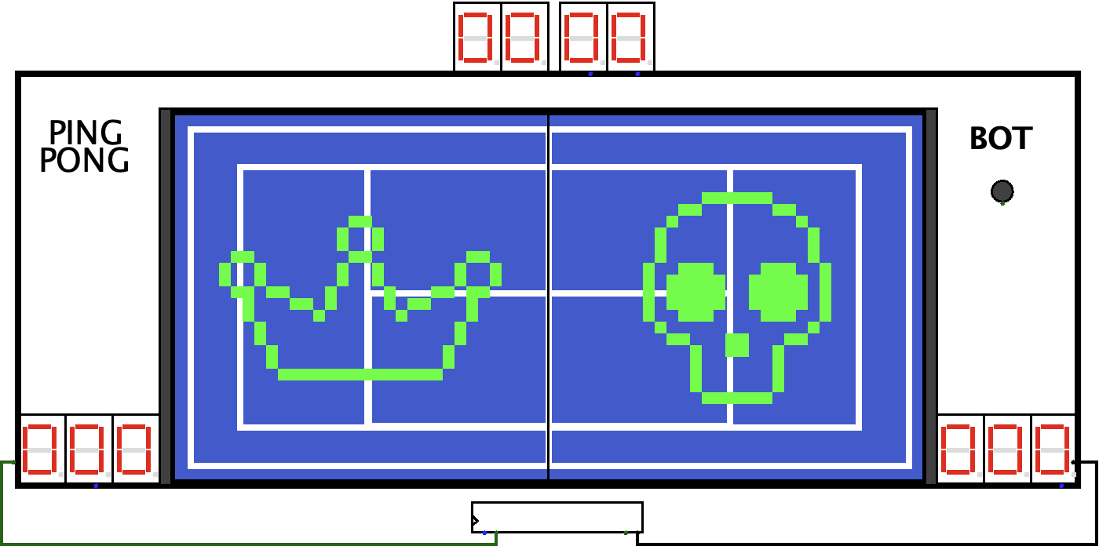

Slide 12
Logisim

Slide 13
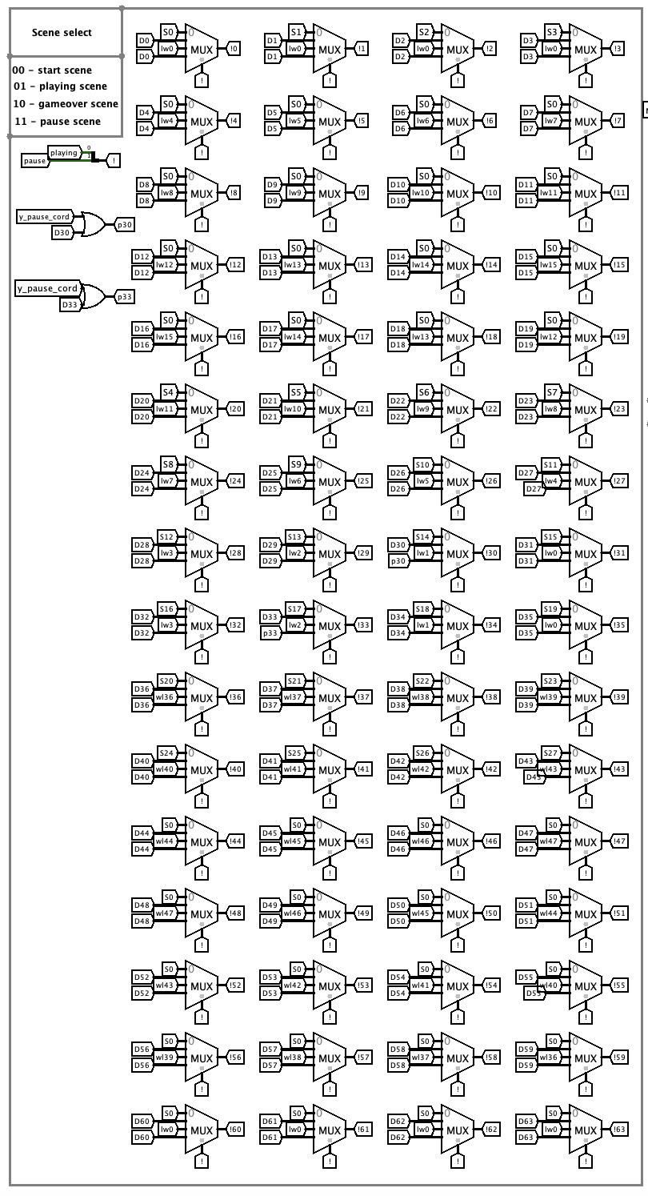
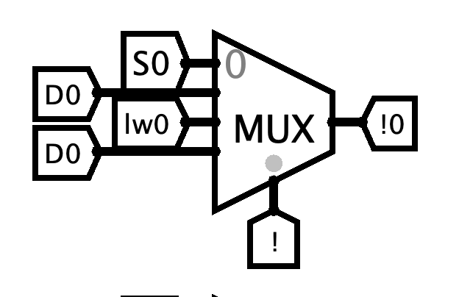
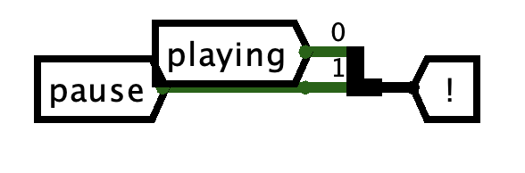
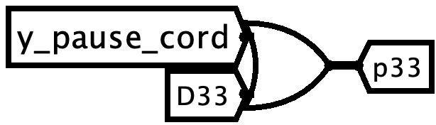
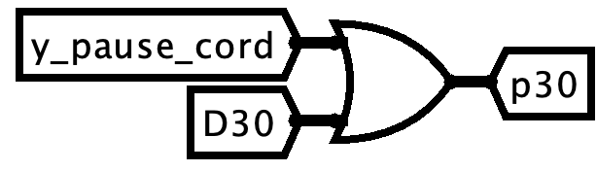
How do we choose which screen to display?
Start screen – 00
Playing screen – 01
Gameover screen – 10
Pause screen – 11

Slide 14
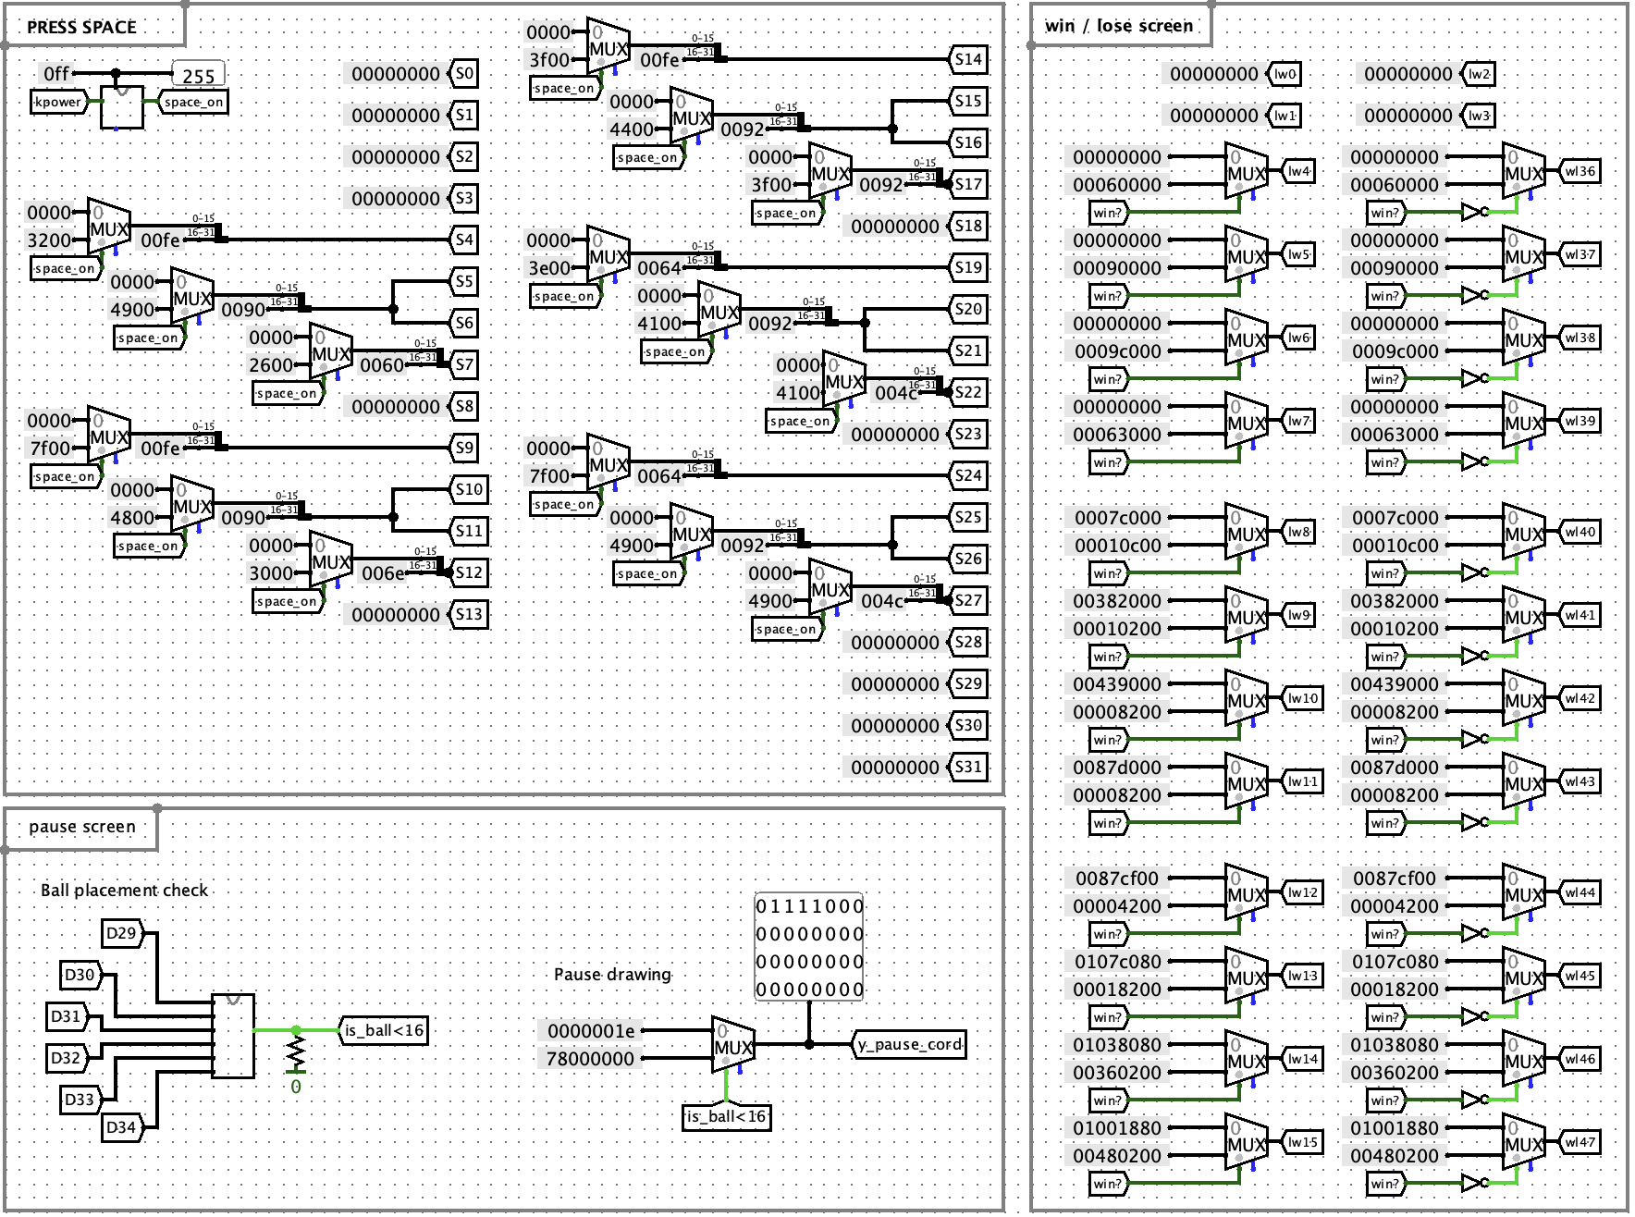
How do we choose the values for these screens?

Slide 15
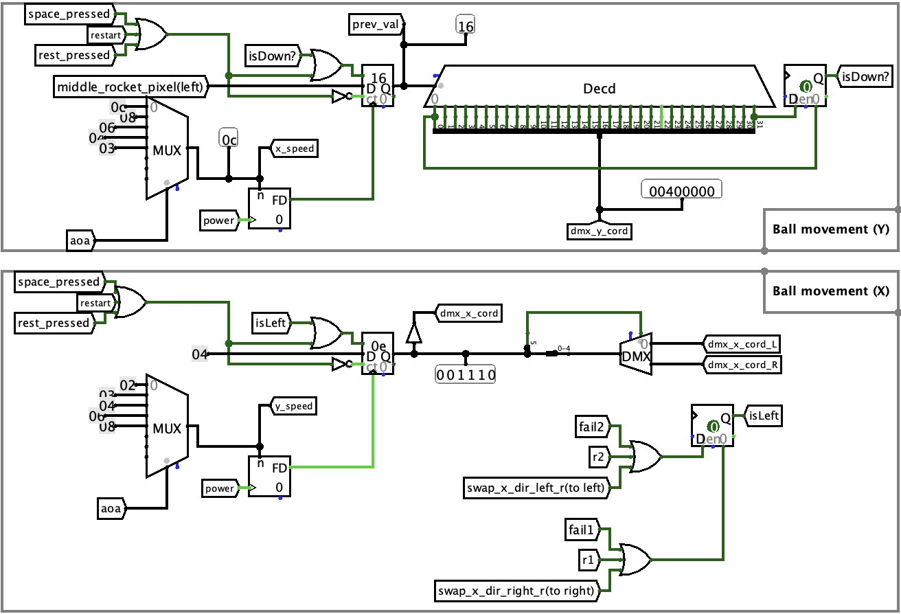
The ball movement

Slide 16
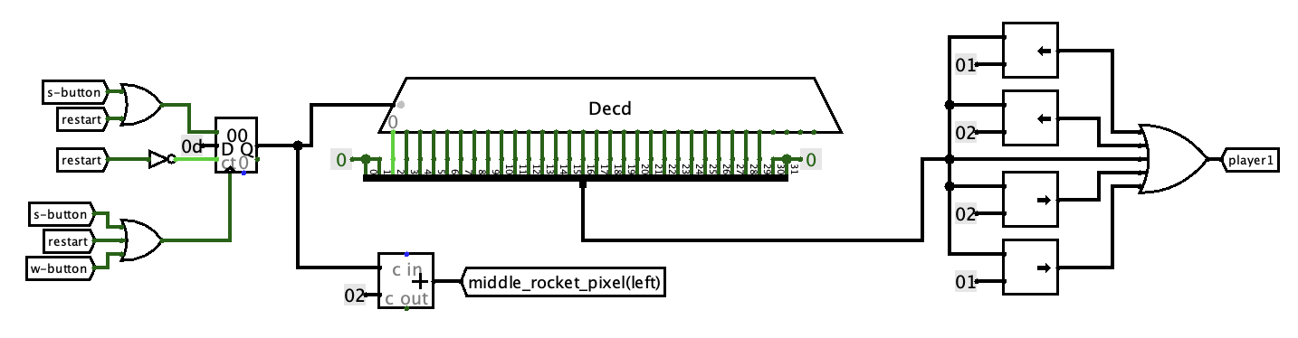
Player movement

Slide 17
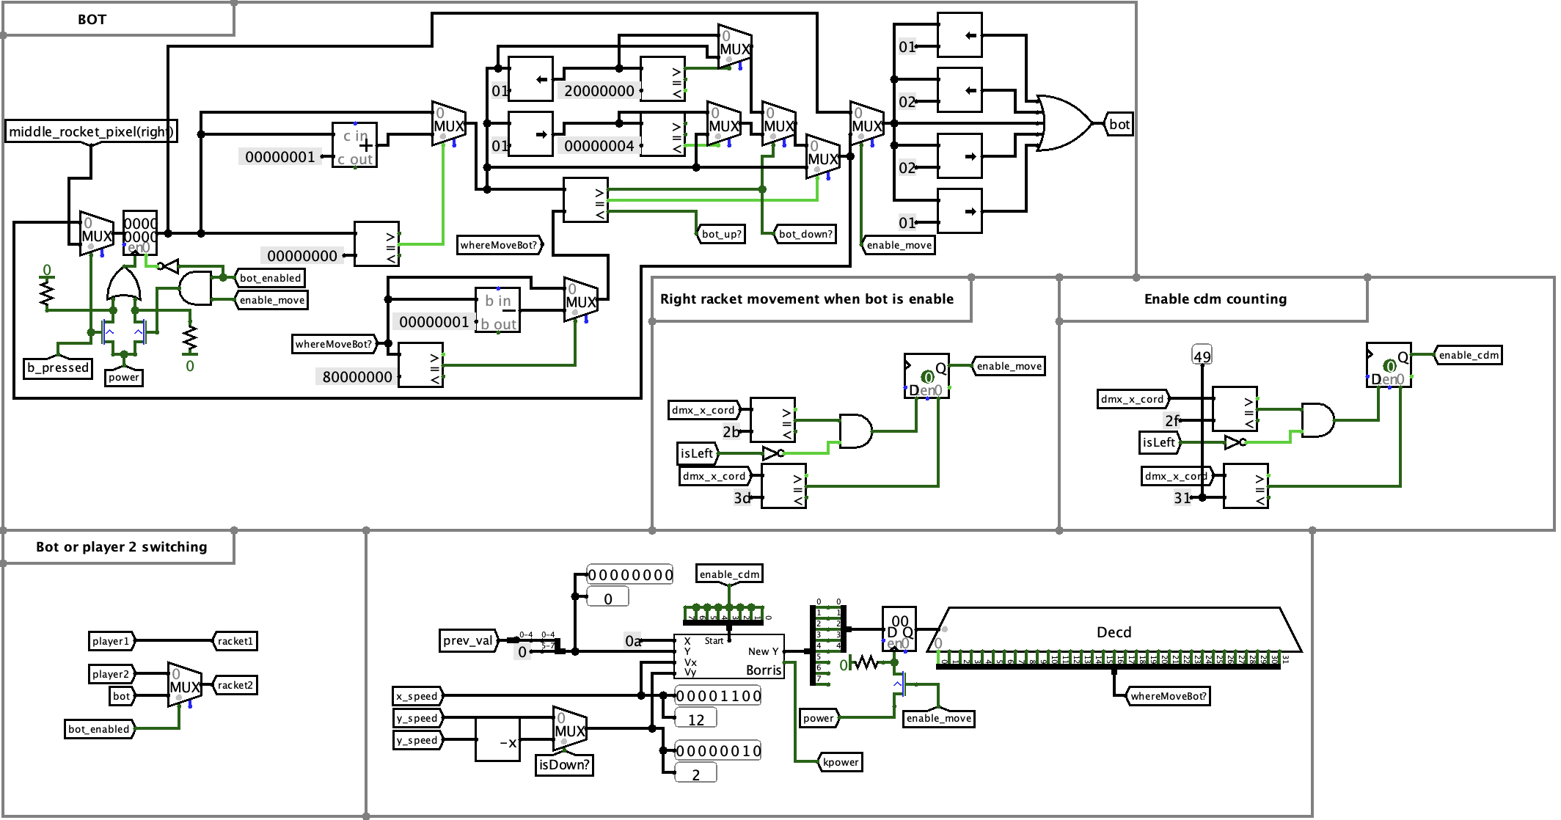
Bot movement

Slide 18
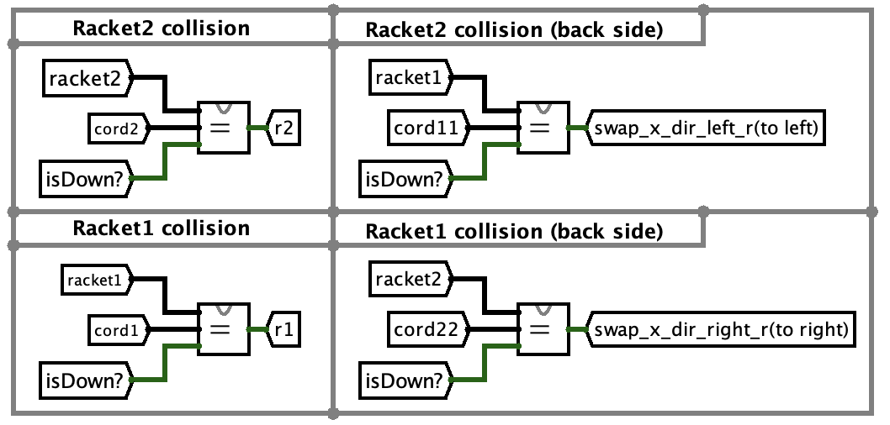
Ball and racket collision test

Slide 19
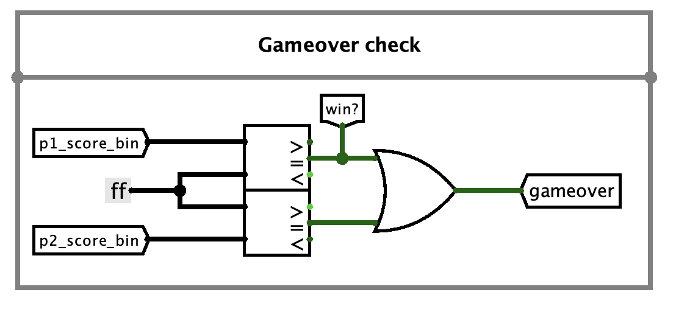
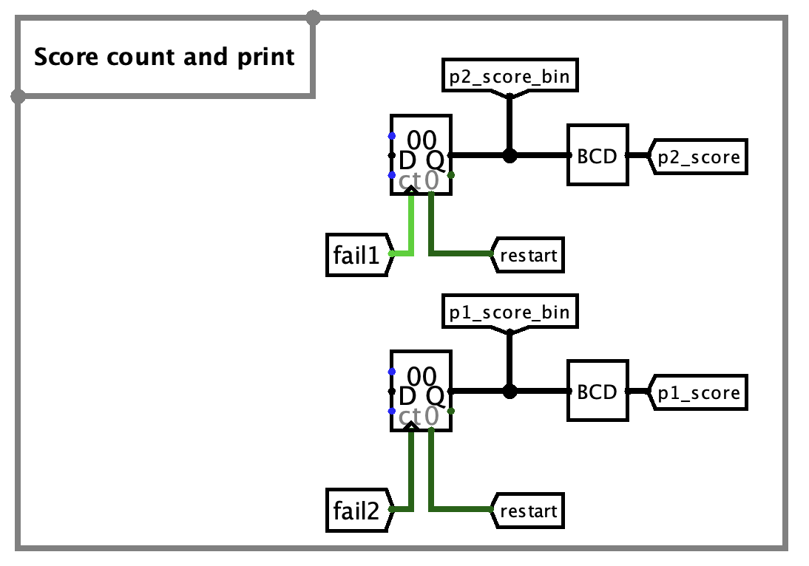
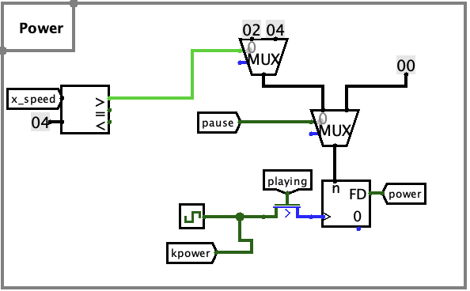
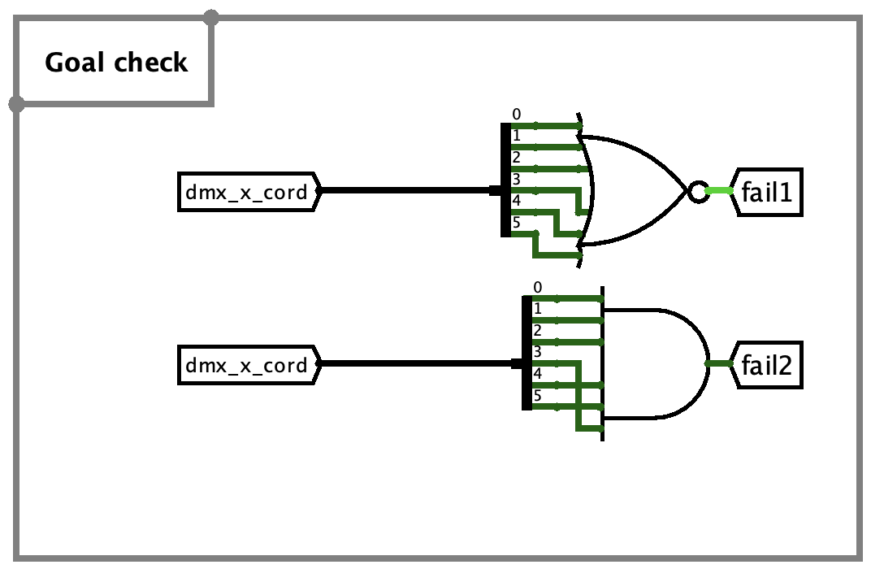
Misc

Slide 20
Subcircuits

Slide 21
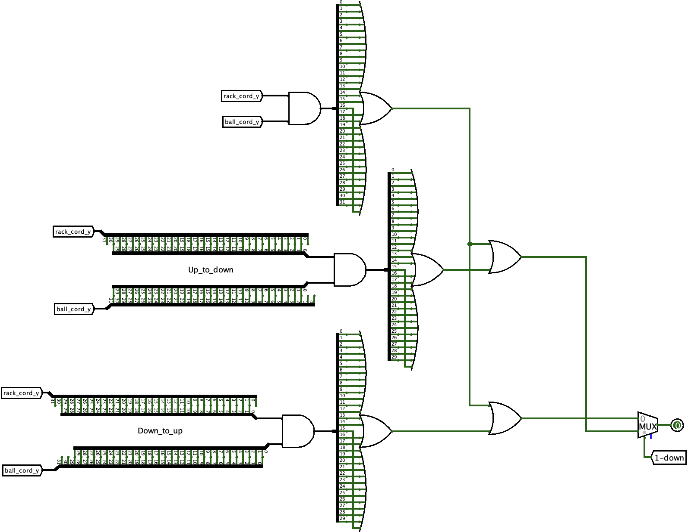
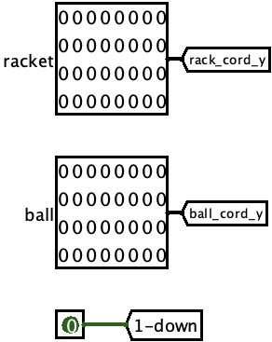
Comp-y-coord
Purpose: checks for ball and racket collision.
attack variations:

Slide 22
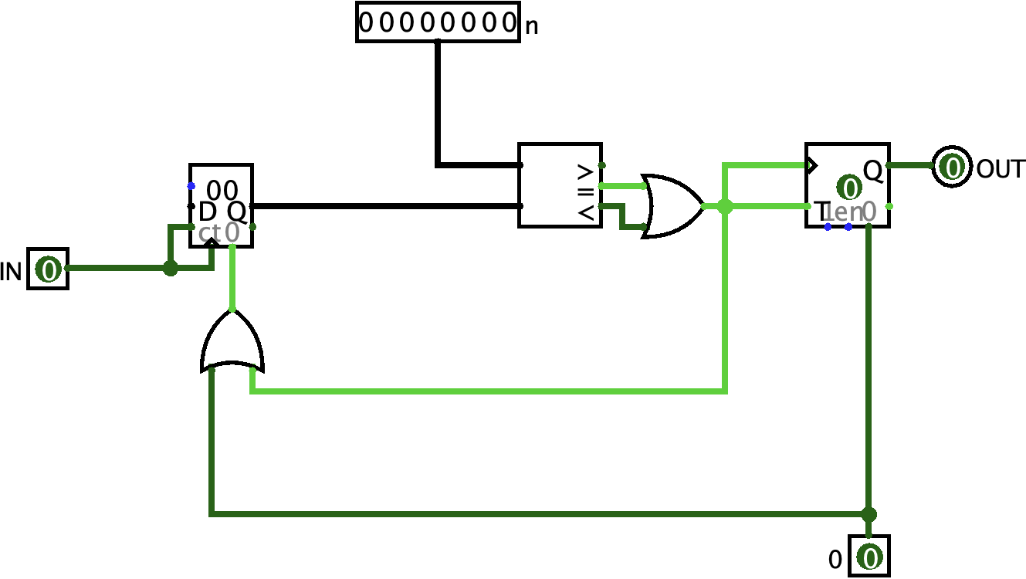
Frequency divider
Purpose: added control of the clock rate.
Use cases:
timer
flashing “SPACE” text
ball movement
register the last button press

Slide 23
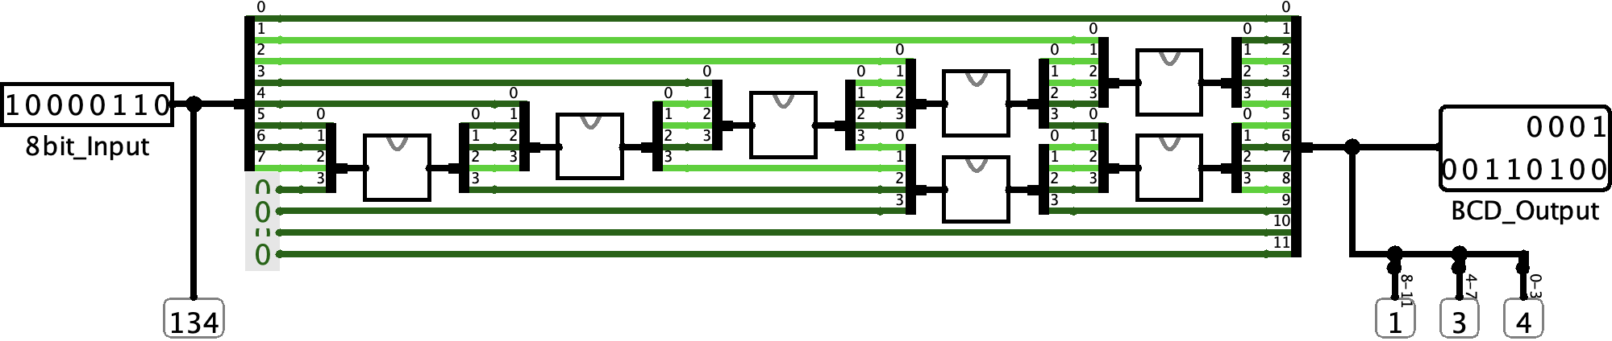
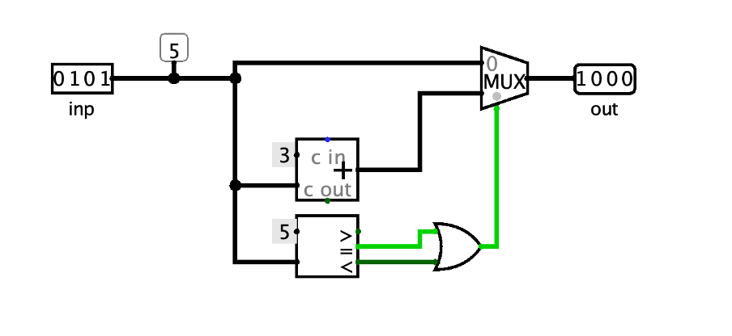
Binary Coded Decimal
Purpose: convert 8bit number into 12 bit BCD representation
BCD HELPER

Slide 24
Pause
Purpose:
position the pause icon such that it does not overlap with the ball

Slide 25
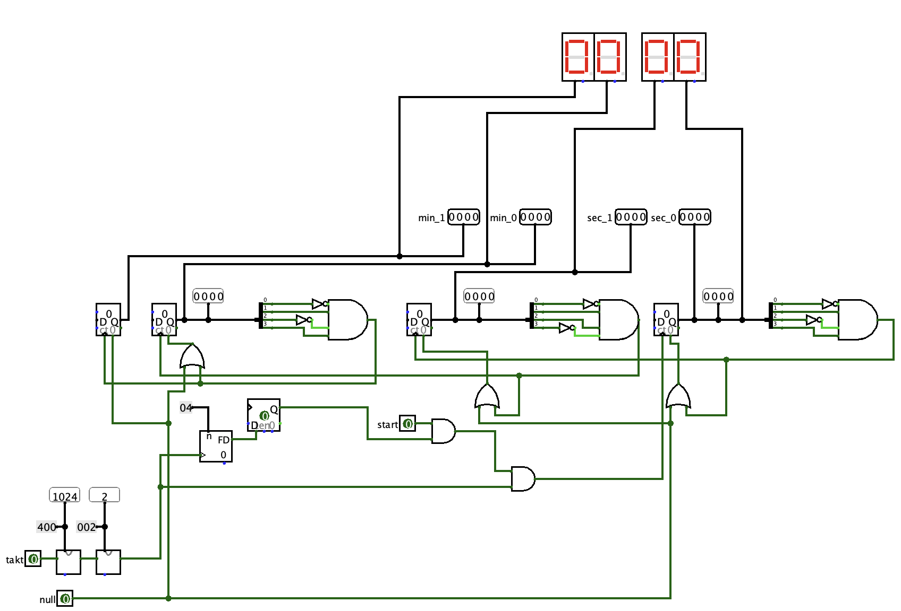
Stopwatch
Purpose: it’s a stopwatch

Slide 26
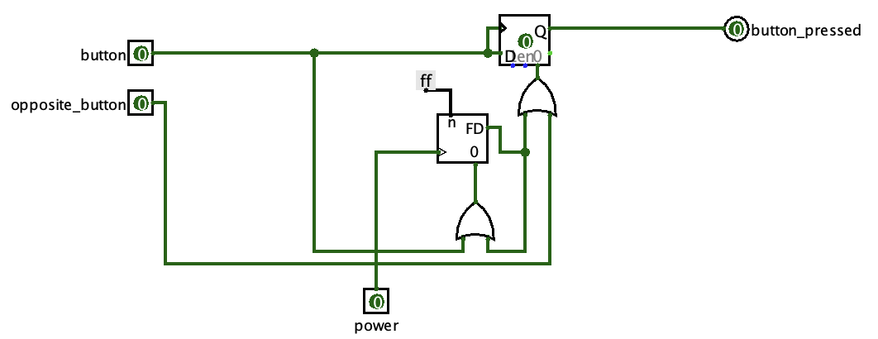
Last button pressed
Purpose: extend the signal in the raised state

Slide 27
CdM8

Slide 28
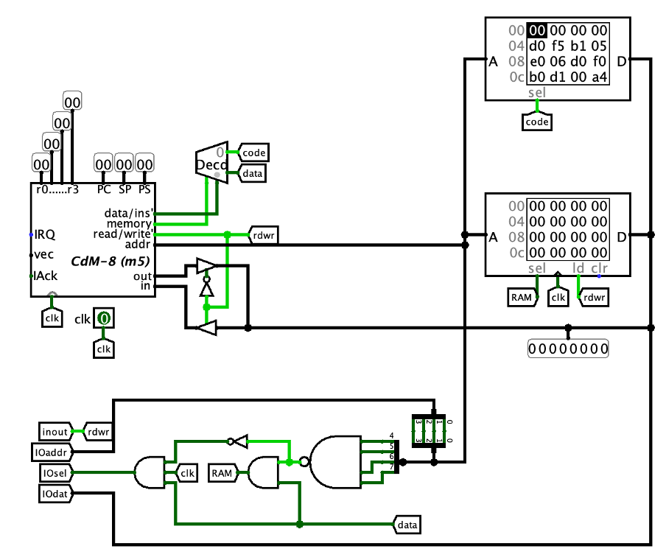
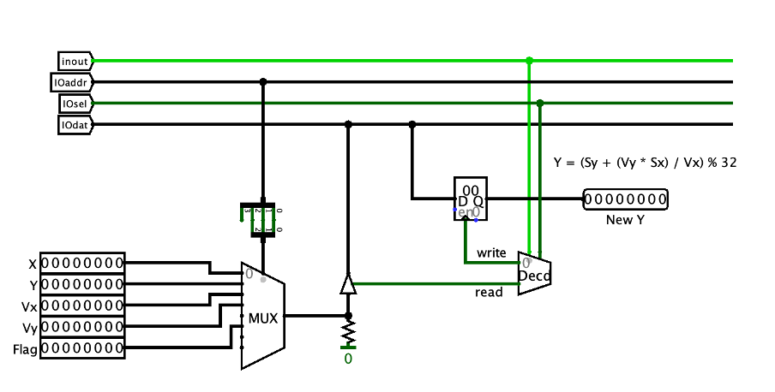
Bot Borris
Purpose: bot for single player mode
Harvard architecture
0xF0 — 0xFF reserved for I/O

Slide 29
Bot Borris
YNEW = (Sy + (Vy * Sx) / Vx) % 32
VY = VY * SX
t = VY / Vx
SY = SY (+/–) t
SY = SY % 32

Slide 30
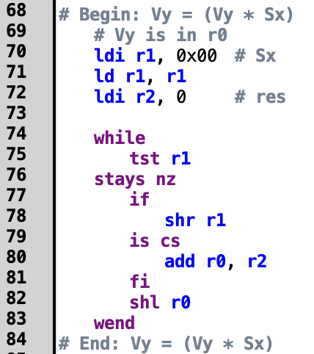

Slide 31
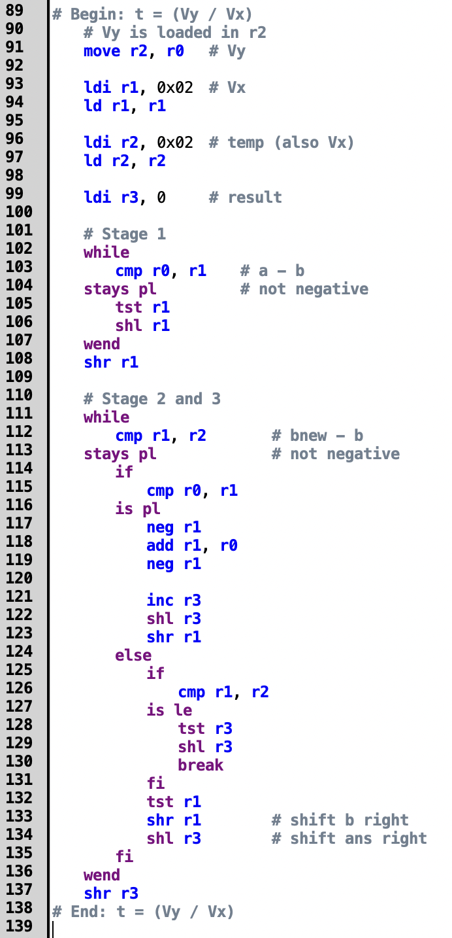

Slide 32
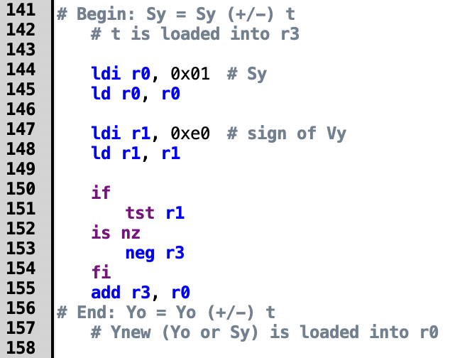

Slide 33
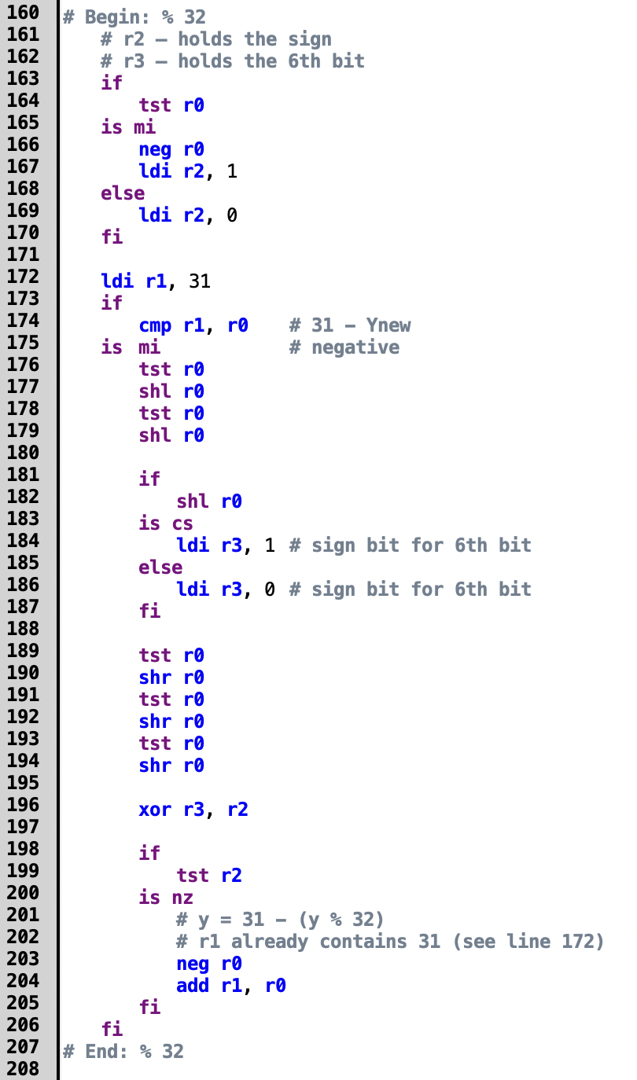

Slide 34
Conclusion
We were able to successfully create a working version of Pong in Logisim
Our improvements
Single player mode, enabled by BotBorris
Bigger screen
More colors
Improved game mechanics

Slide 35
Thank you

Slide 36
DEMO

Slide 37
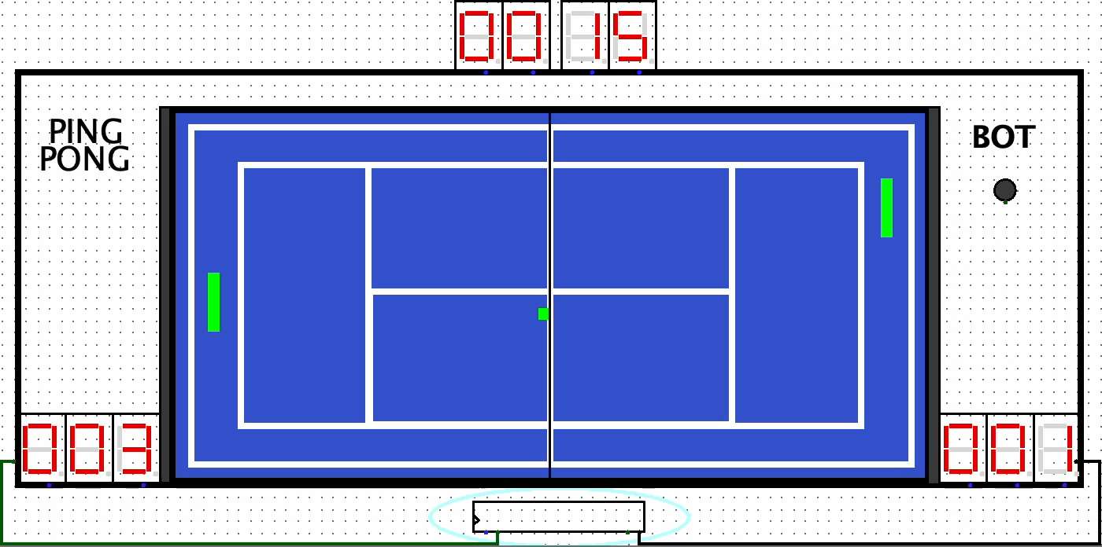

Slide 38
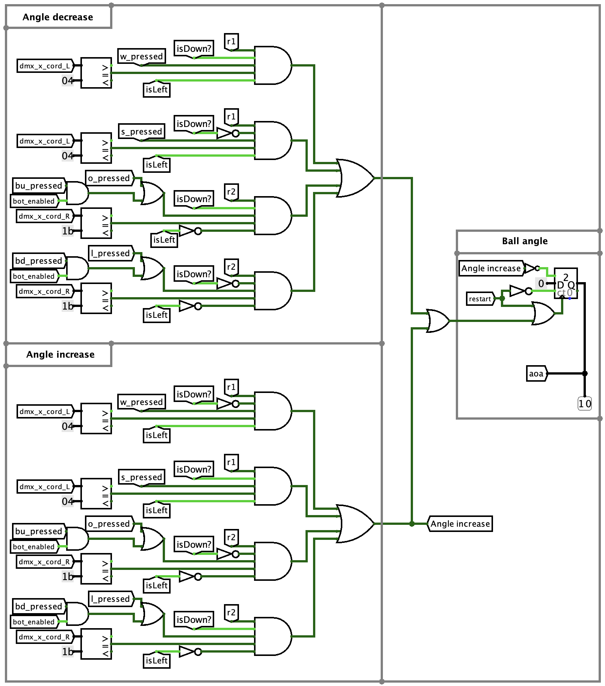
Changing the angle of attack of the ball

Slide 39
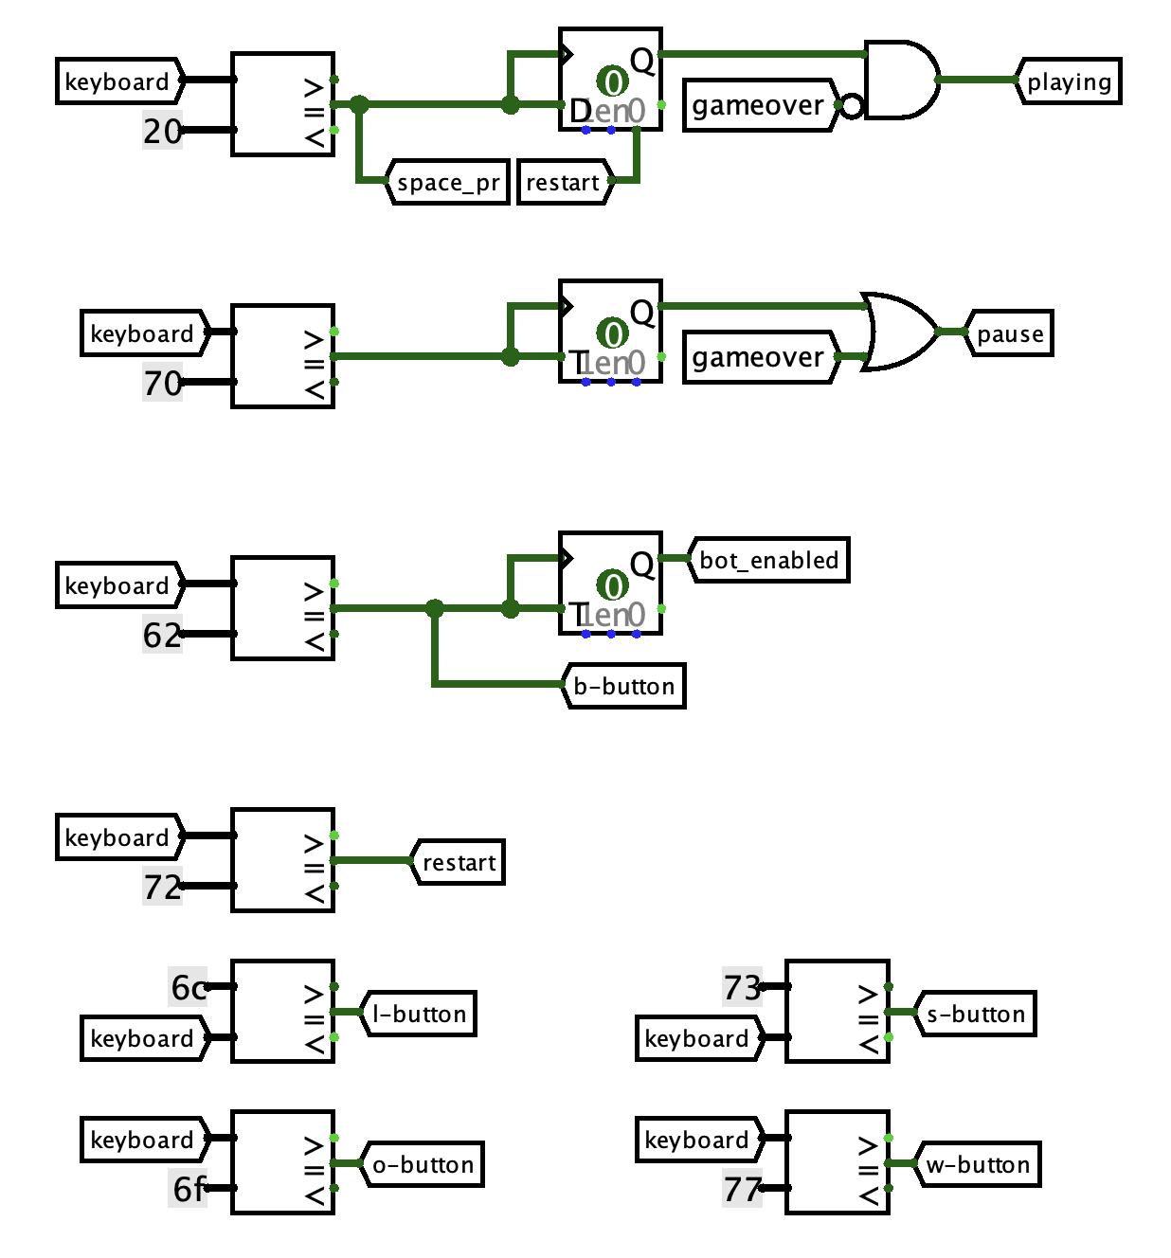
Keyboard Input

Slide 40
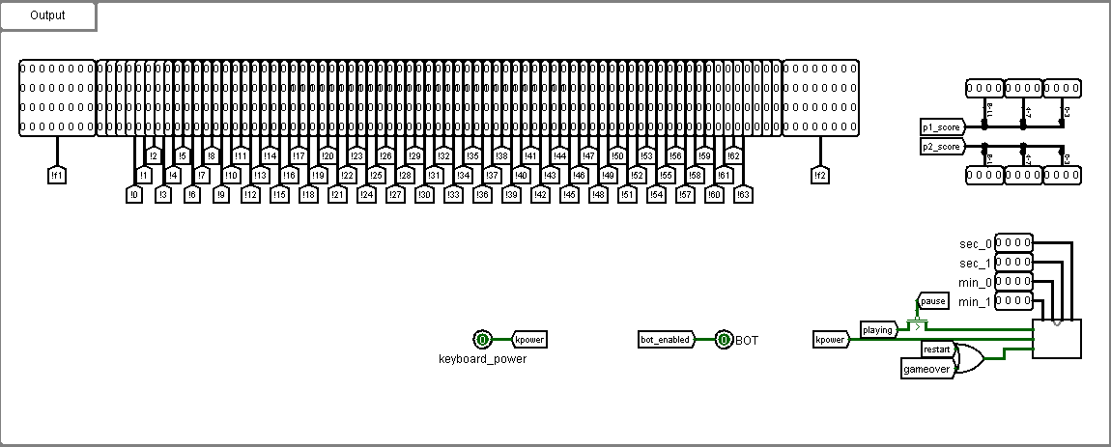
Contacts for data transfer between two circuits

Slide 41
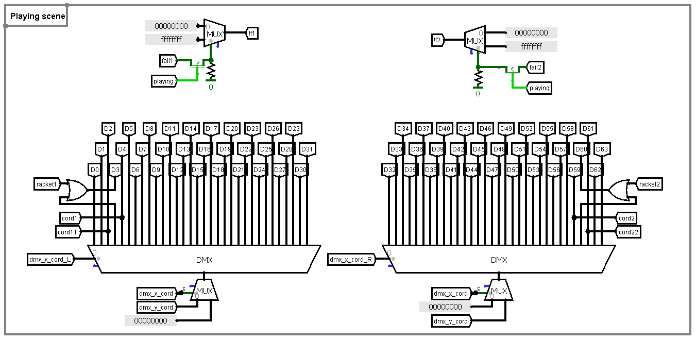
Playing screen

Slide 42
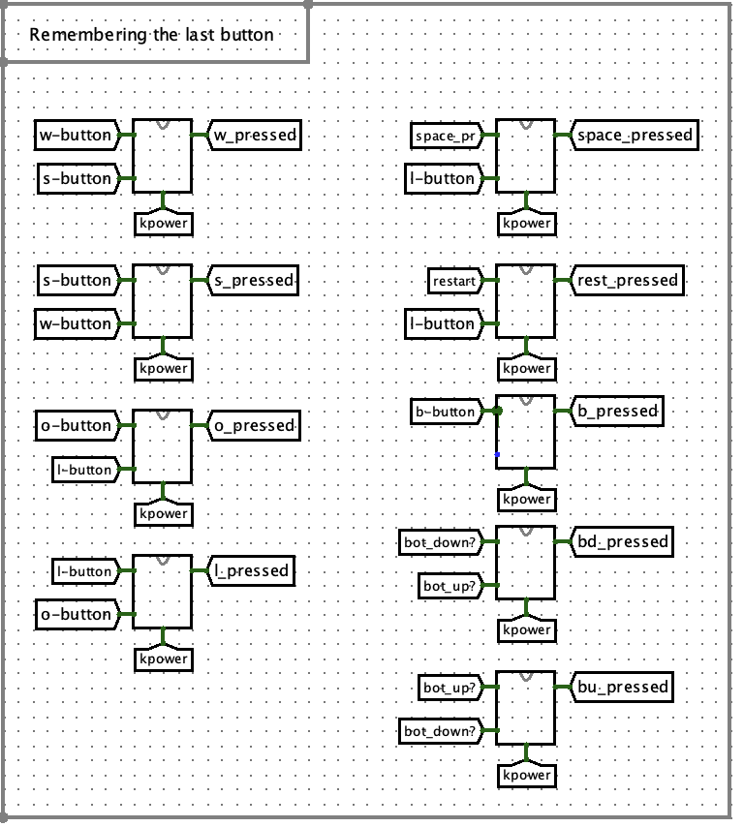
Keyboard Input
Remembering the last button press

